Slide 1

Digit recognizer
Machine Learning Mini-Project
Presented By:
Guruprasad Patil (1803033)
Shubham Patil (1803034)
Shubham Chavan (1803046)
Swapnil Khot (1803047)
Randheer Patil (1803048)
Guided By:
Prof. Dr. S.A.Thorat
Notes:
PLEASE READ NOTE SECTION FOR DETAILS OF SLIDES.

Slide 2

OUTLINE
Introduction and Motivation
Data Source
Proposed Architecture
Model Demonstration
Testing the model
Results and Discussion
Conclusion and Future Scope
References

Slide 3
1 . INTRODUCTION AND MOTIVATION
What is digit recognizer and what is its need?

Slide 4
INTRODUCTION
Handwritten digit recognition is the ability of a computer to recognize the human handwritten digits from different sources like images, papers, touch screens, etc, and classify them into 10 predefined classes (0-9)
The aim of a handwriting digit recognition system is to convert handwritten digits into machine readable formats
The main objective of this work is to ensure effective and reliable approaches for recognition of handwritten digits and make banking operations easier and error free

Slide 5
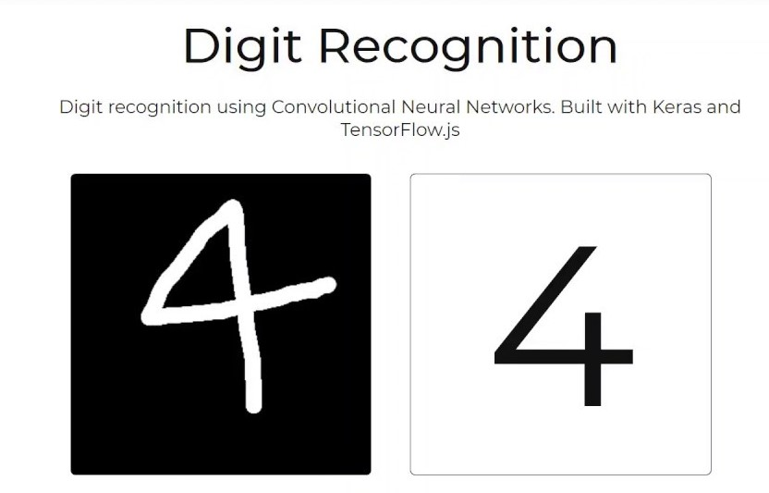
INTRODUCTION AND MOTIVATION
Digit recognition has many applications like number plate recognition, postal mail sorting, bank check processing, etc.
In Handwritten digit recognition, we face many challenges because of different styles of writing of different peoples as it is not an Optical character recognition

Slide 6
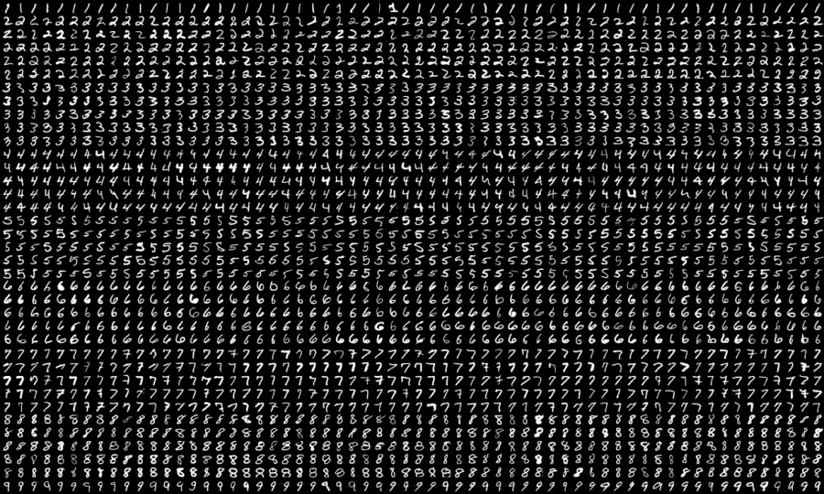
PROBLEM STATEMENT
To recognize the hand written digits for the banking systems and other digital firms is becoming more harder. So there is a need to develop a machine learning model to recognize the hand written digits.

Slide 7

OBJECTIVES
To recognize the hand written digits
To analyse performance of model on identified dataset.
To identify best machine learning algorithm for digit recognition.
.

Slide 8
2 . DATA SOURCE
Dataset information, history of dataset and its attribute’s details

Slide 9
DATA SOURCE
The dataset was referred from a Kaggle competition
MNIST ("Modified National Institute of Standards and Technology") is the de facto “hello world” dataset of computer vision.
Since its release in 1999, this classic dataset of handwritten images has served as the basis for benchmarking classification algorithms.
As new machine learning techniques emerge, MNIST remains a reliable resource for researchers and learners alike.

Slide 10


DATASET DETAILS
train.csv : training dataset with the following attributes:
pixel0-pixel784
Label :
Numbers from 0-9
test.csv: testing dataset contain same attributes as train.csv but without the label.
Notes:
Dataset is obtained from Kaggle.
It contains two files train.csv and test.csv.
As the name suggest train.csv is used for training and validation and test.csv is used for testing.
Train dataset contains label whereas in test dataset label is missing we have to predict label whether the news is real or fake.
Evaluation is done on only for training dataset because we know labels.

Slide 11
3. PROPOSED ARCHITECTURE
How model works ?

Slide 12
PROPOSED ARCHITECTURE
Training
Train Dataset
Pre-Processing
Feature Extraction
Train Model
(Keras,Tensorflow, Sequential,....,etc.)
Recognize Digit
Testing
Test Dataset
Pre-Processing
Feature Extraction
Predict the digit between 0-9
Notes:
First we perform pre-processing on identified dataset which includes tokenization, stopword removal and lemmatization.
Tokenization is nothing but splitting of sentences into words.
After tokenization we remove stopwords because presence of stopwords does not signify importance for evaluation of sentences.
Then we perform lemmatization which is a process of reducing words to common base form.
So why we perform lemmatization because machine does not know play, played and playing are the same words so we reduce to common base form play.
Machine does not understand human language so to build machine learning model we have to convert text into numbers; for this we use TFIDF Vectorizer.
In train model phase identified train dataset is split into train set and validation set. Model is actually built on train dataset. Building a model actually means training classifier on features. then this trained classifiers' performance is evaluated on validation set.
From train and validation set we derive accuracy,precision,recall,etc to determine best classifier.
Similarly preprocessing and feature extraction is carried out on test dataset.
Previously trained best classifier is then utilized for prediction of test dataset depending upon test dataset features. here predictions is in the form of real or fake news.
Classifiers utilized for building model are DTC,KNN,RFC,MNB,SVM,MLP.

Slide 13
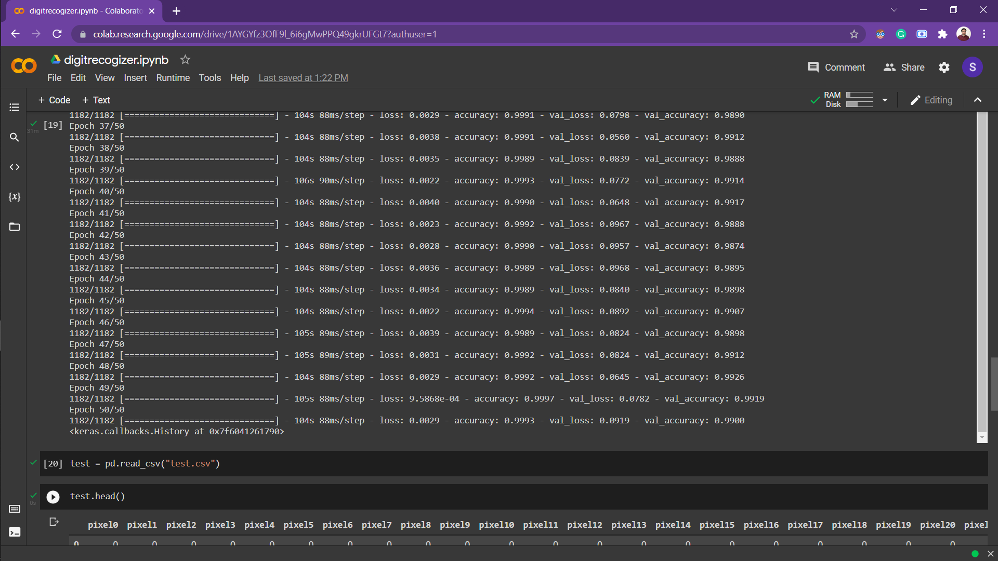
VALIDATION : Model Evaluation - RESULTS
Model Accuracy : 98.92%

Slide 14
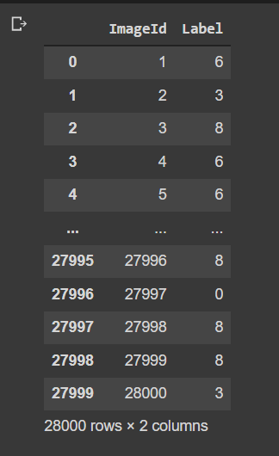
RESULTS AND DISCUSSION Predicted and Actual Results for RFC on Test Dataset
ROWS:
Rows are the individual ImageIDs
COLUMNS (with Label1):
The prediction of every image as per the models prediction
COLUMN (ImageID):
This is the ImageID of the specific test images in the dataset

Slide 15
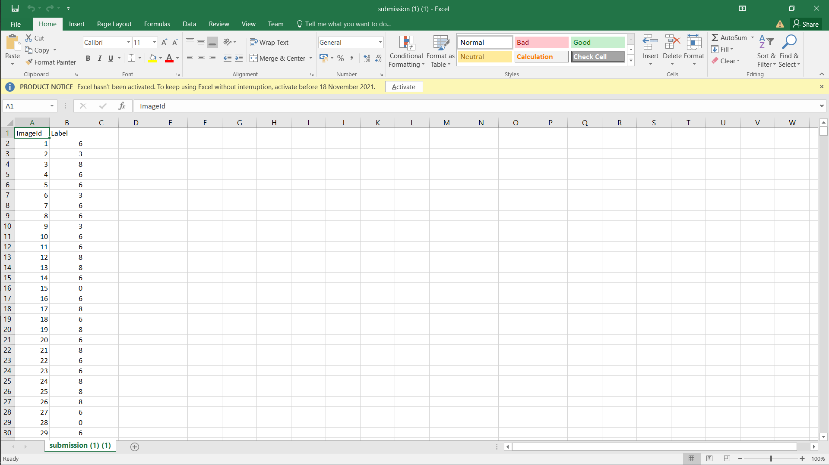
TEST DATASET Model Evaluation – PREDICTION RESULTS
ROWS:
Rows are the individual ImageIDs
COLUMNS (with Label1):
The prediction of every image as per the models prediction
COLUMN (ImageID):
This is the ImageID of the specific test images in the dataset

Slide 16
References
Data Source: https://www.kaggle.com/c/digit-recognizer/data
https://towardsdatascience.com/the-best-machine-learning-algorithm-for-handwritten-digits-recognition-2c6089ad8f09https://www.youtube.com/watch?v=xyq-zYr1cnI&t=1527s
https://arxiv.org/pdf/2106.12614.pdf

Slide 17
Thank You

